Slide 1

Title : Keyloggers
Presented by M Jamlludeen at Aalim Muhammed Salegh College of Engineering, this presentation explores the intricacies of keyloggers - powerful software tools that record every keystroke on a computer
Notes:
1

Slide 2
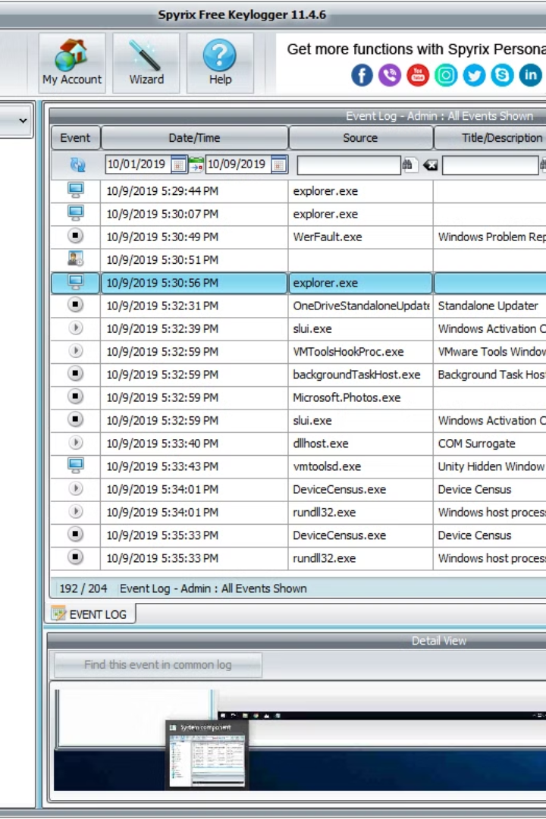
Problem Statement
Develop a robust system to detect and prevent keylogger activities on computer systems. The system should be able to:
Identify and differentiate between legitimate keyboard inputs and potentially malicious keystroke logging activities.
Implement techniques to detect the presence of keylogging software or hardware devices on the system.
Provide real-time monitoring and alerts for suspicious keyboard activities.
Offer methods for preventing unauthorized access to sensitive data, even in the presence of keyloggers.
Ensure user privacy and data security while detecting and mitigating keylogger threats.
Develop user-friendly interfaces and reporting mechanisms for system administrators and end-users to manage keylogger detection and prevention features effectively.
Notes:
2

Slide 3
Proposed System/Solution
A keylogger is a type of software or hardware device that records keystrokes typed on a computer or mobile device. Keyloggers can be used for various purposes, both legitimate and malicious. In a proposed system or solution, keyloggers can be implemented for legitimate purposes such as:
Employee Monitoring:
Employers can use keyloggers to monitor employees' activities to ensure they are using company resources appropriately and not engaging in unauthorized activities
Parental Control:
Parents can use keyloggers to monitor their children's online activities and protect them from harmful content or interactions.
Employee Monitoring:
Employers can use keyloggers to monitor employees' activities to ensure they are using company resources appropriately and not engaging in unauthorized activities
Information Security:
Keyloggers can be used to detect unauthorized access or data breaches by logging all keystrokes and identifying suspicious activities.
Notes:
3

Slide 4

System Development Approach
1
Agile Methodology
2
Collaborative Prototyping
Adopting an agile approach to ensure iterative development and quick responses to security threats.
Using collaborative prototyping to gather feedback and improve system resilience against keyloggers.
3
Threat Modeling
Employing threat modeling to proactively identify keylogger vulnerabilities within the system.
Notes:
4

Slide 5
Algorithm & Deployment
Machine Learning
Utilize machine learning algorithms to detect anomalous typing patterns.
Cloud Integration
Integration with cloud-based keylogger detection and prevention services.
Continuous Updates
Ensure continuous updates of the system to counter emerging keylogger threats.
Notes:
5

Slide 6
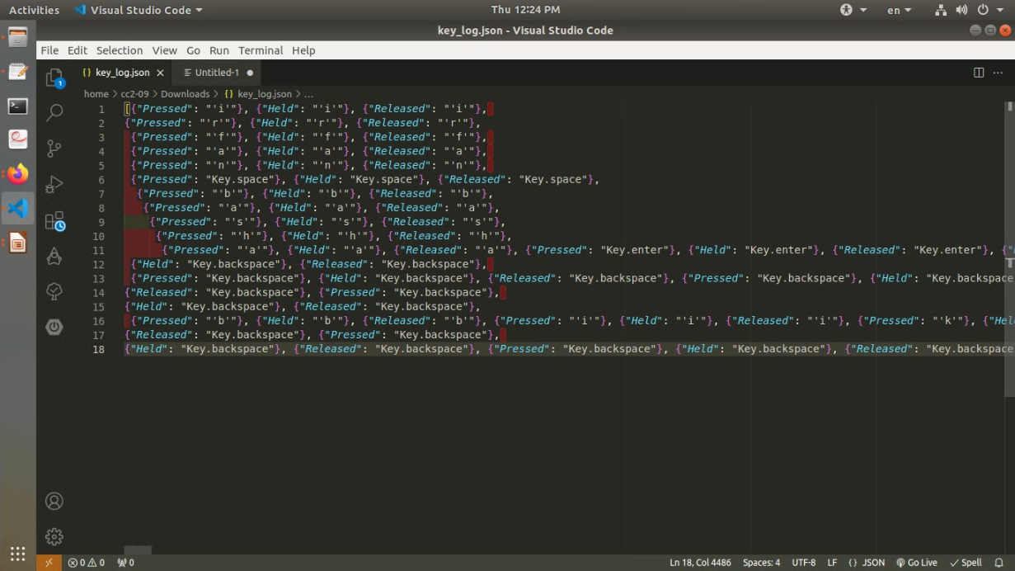
Result (Output Image)
Notes:
6

Slide 7



Conclusion
Success in Mitigation
User Confidence
Future Enhancements
Users can have confidence in the security and privacy of their interactions.
The system has shown reliable mitigation results against keylogger attacks.
Possible enhancements to further strengthen the system's defense against keyloggers.
Notes:
7

Slide 8

Future Scope
1
Advanced Encryption
Exploration of advanced encryption methods to counter evolving keylogging techniques.
2
AI Integration
Research on integrating AI for predictive identification and prevention of keylogger threats.
3
User Education
Development of user education programs to raise awareness about keylogger risks.
Notes:
8

Slide 9

References
Security Journals
Industry Reports
Expert Interviews
References to in-depth studies and findings in leading cybersecurity journals.
Insights from industry reports and publications related to keylogger threats and solutions.
Interviews with cybersecurity experts shedding light on keylogger defense strategies.
Notes:
9

Slide 10
Thank You !
Notes:
10

